Slide 1


Renton Fish and Game Club
USPSA
May 2022
Match Booklet
Match Director: Marcel Englmaier
Range Master: Jordan Rogers
Stats: Eric Beerbaum
Round Count: ~175

Slide 2
Bay 1, Stage 1 Copy Paste Course Designer: Jordan Rogers
Copy Paste is a 30 round, 150 point Comstock long course. There are 14 USPSA targets and 2 steel targets. The best two hits per target will score. Steel must fall to score. The start signal is audible.
The Handgun start position is loaded and holstered, hands touching the upper pair of marks on the up-range wall. The PCC start position is loaded with muzzle touching the lower mark on the up-range wall.
On the audible start signal, engage all targets as visible from within the shooting area. PP2 activates the drop turner, which is a disappearing target. All barrels are soft cover.

Slide 3
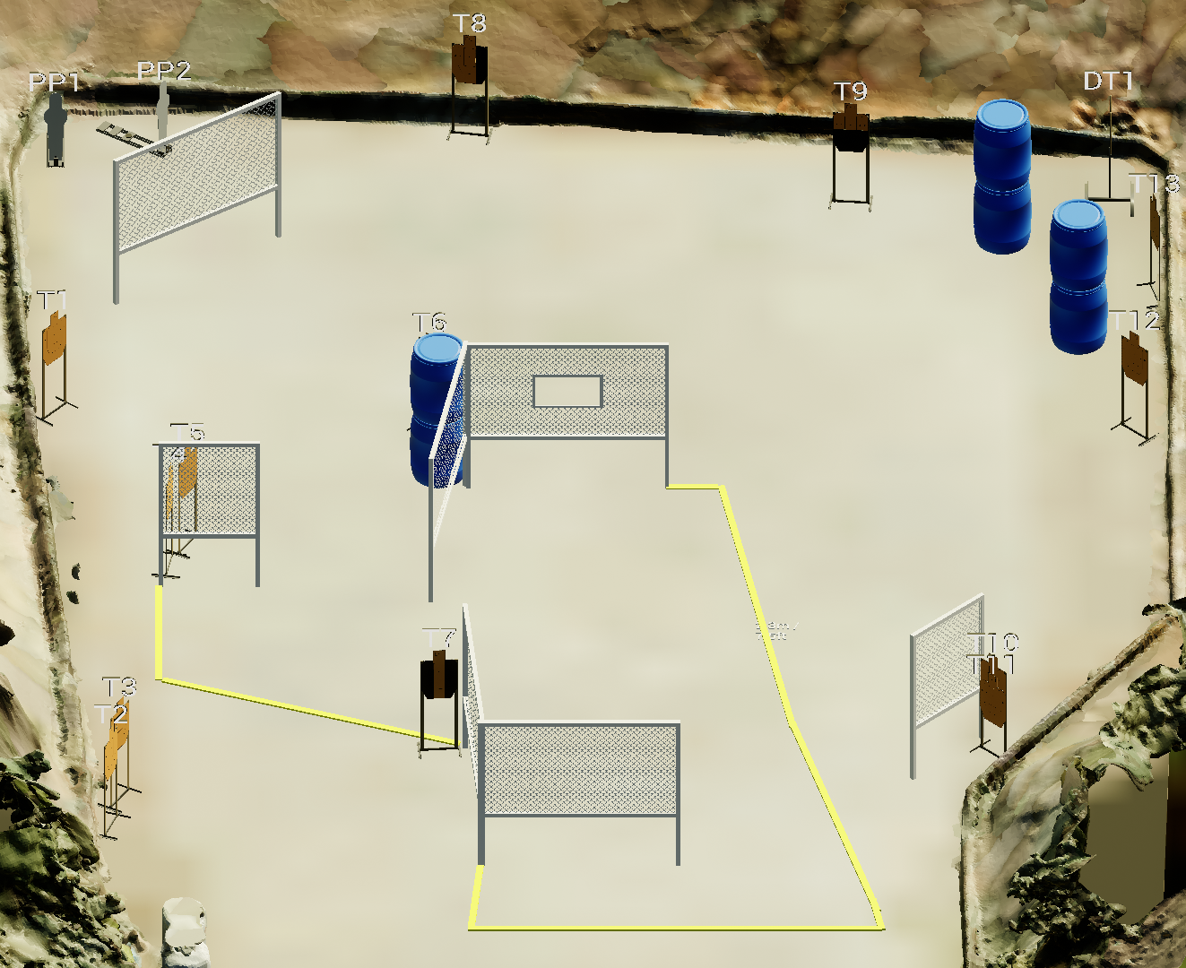
 | Stage 1 Copy Paste Course Designer: Jordan Rogers
xx
x

Slide 4
Bay 2, Stage 2 Weak Already? Course Designer: Loke Tan
Weak Already? is an 11 round, 55 point Comstock Medium course. There are 3 IPSC targets and 5 steel targets. The best two hits per target will score. Steel must fall to score. The start signal is audible.
The start position is standing in the shooting box with wrists above respective shoulders. Firearm is unloaded, lying flat and unsupported on the table with muzzle pointed downrange.
On the audible start signal, engage all targets from within the shooting box. The last 6 required shots must be made using strong hand only.

Slide 5
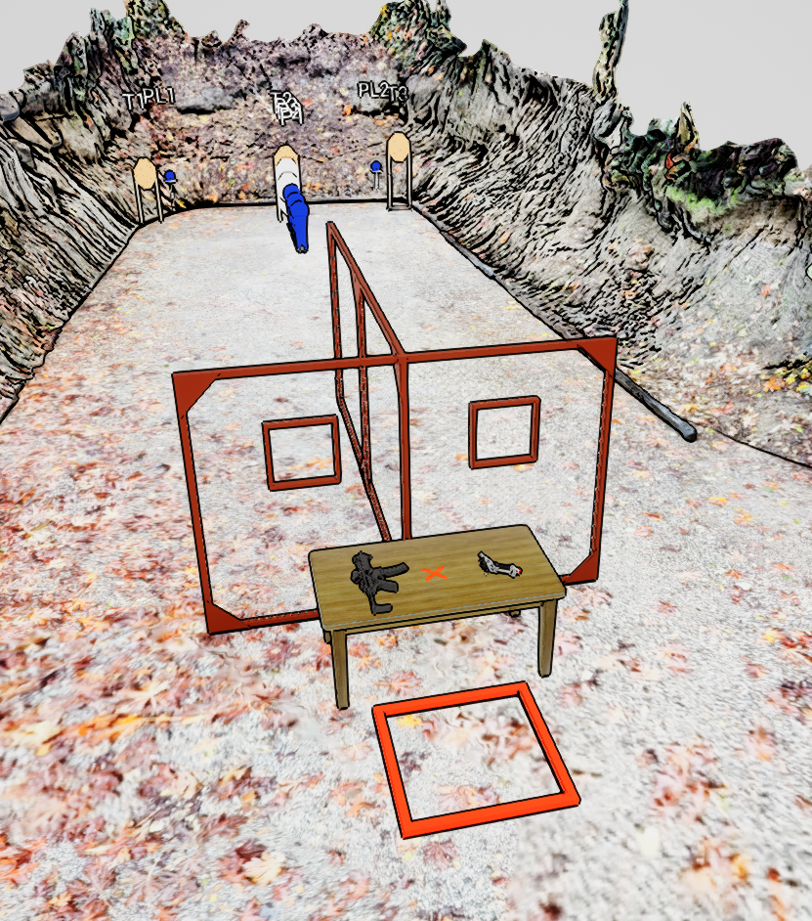
 | Stage 2 Weak Already? Course Designer: Loke Tan

Slide 6
Bay 3, Stage 3 Summer Slam 9 Course Designer: Marcel Englmaier
Summer Slam 9 is a 24 round, 120 point Comstock Long course. There are 12 IPSC targets. The best two hits per target will score. The start signal is audible.
The Handgun start position is standing anywhere in the shooting area with wrists below belt. Handgun is loaded and holstered. The PCC start position is standing anywhere in the shooting area with PCC stock on belt, muzzle pointing downrange, and safety on.
On the audible start signal, engage all targets from within the shooting area.

Slide 7
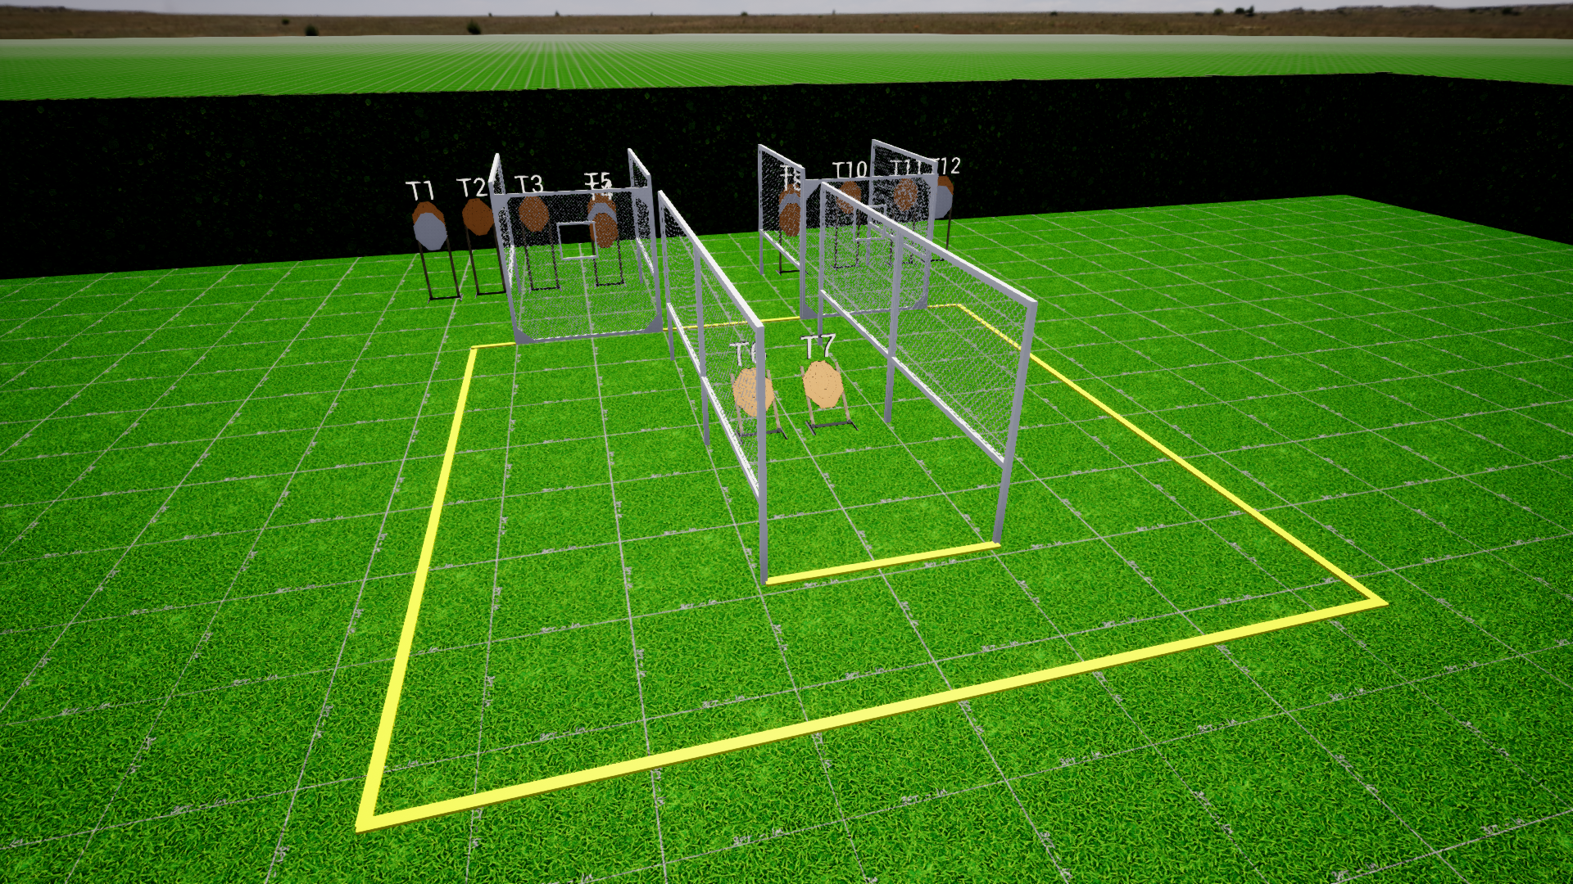
 | Stage 3 Summer Slam 9 Course Designer: Marcel Englmaier

Slide 8
Bay 3.5, Stage 4 8 Aces (For That Instagram Run) Course Designer: Marcel Englmaier
8 aces is an 9 round, 45 point Virginia Count Standards Exercise. There are 5 USPSA targets. The best one hit on T1 and the best two hits on T2-T5 will score. The start signal is audible.
The Handgun start position is standing in shooting box with wrists below belt. Handgun is loaded and holstered. Loading devices may be staged on the table. The PCC start position is standing in shooting box with with stock on belt. PCC is loaded with safety on and muzzle pointed downrange. Loading devices may be staged on the table.
String 1: On the audible start signal, from within the shooting box, engage T1 with 1 round only. String 2: On the audible start signal, from within the shooting box, engage T2 with 2 rounds only. Perform a mandatory reload and engage T3 with 2 rounds only. Perform a mandatory reload and engage T4 with 2 rounds only. Perform a mandatory reload and engage T5 with 2 rounds only.
Notes:
‹#›

Slide 9
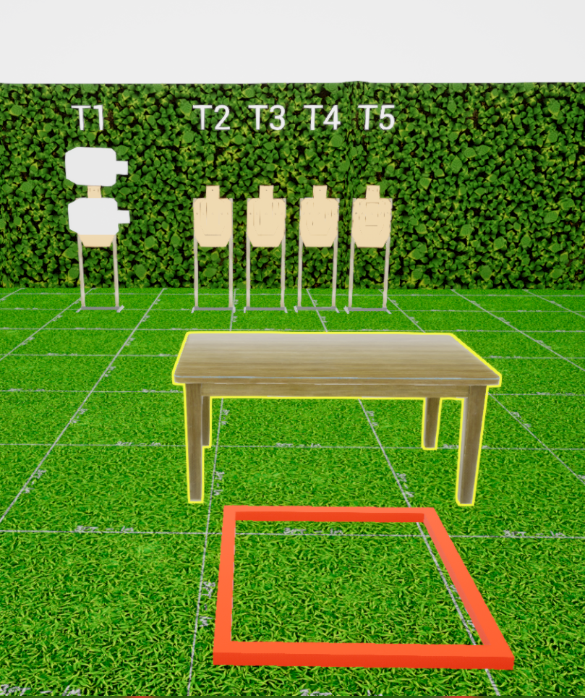
 | Stage 4 8 Aces (For That Instagram Run) Course Designer: Marcel Englmaier

Slide 10
Bay 4, Stage 5 Run Run Run Course Designer: Loke Tan
Run Run Run is a 34 round, 170 point Comstock Long course. There are 11 USPSA targets and 1 steel target. The best three hits per target will score and steel must fall to score. The start signal is audible.
The Handgun start position is standing inside the start box with wrists below belt. Handgun is unloaded and holstered. The PCC start position is standing inside the start box with unloaded PCC stock on belt, muzzle pointing downrange, and safety on.
On the audible start signal, engage all targets from behind the fault line.

Slide 11
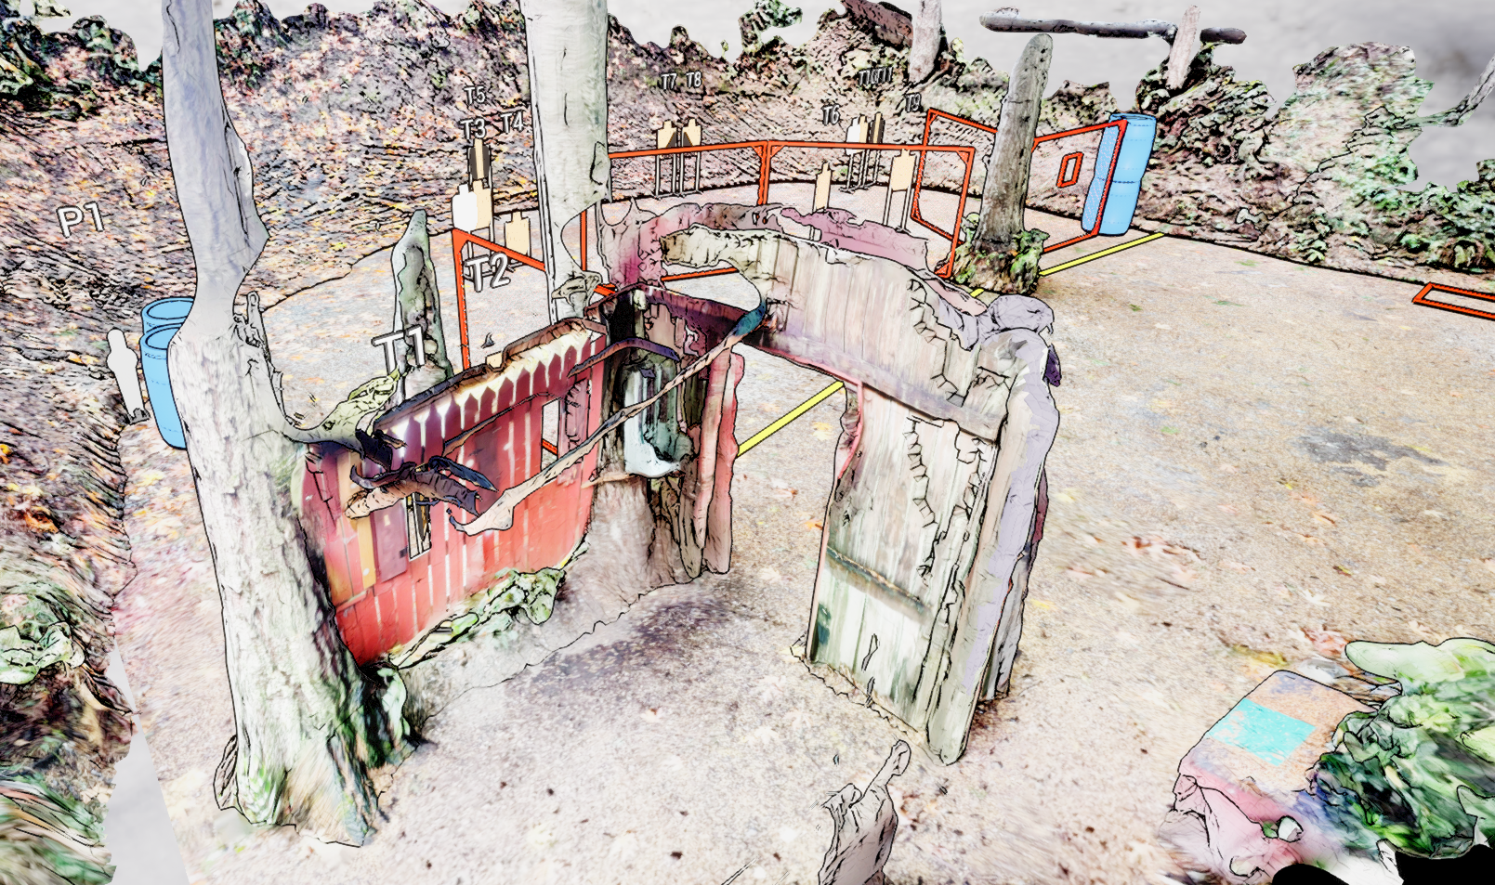
 | Stage 5 Run Run Run Course Designer: Loke Tan

Slide 12
Bay 5, Stage 6 Duck Duck Goose Course Designer: Jordan Rogers
Duck Duck goose is a 23 round, 115 point Comstock long course. There are 12 USPSA targets and one steel target. The best two hits per target will score. Steel must fall to score. The start signal is audible.
The start position is standing anywhere within the shooting area. UNLOADED firearm lying flat and unsupported on barrel. The first ammunition loading device to be used during the course of fire must be on the barrel prior to the start signal.
On the audible start signal, engage targets as visible from within the shooting area. The walls DO NOT extend to infinity.

Slide 13
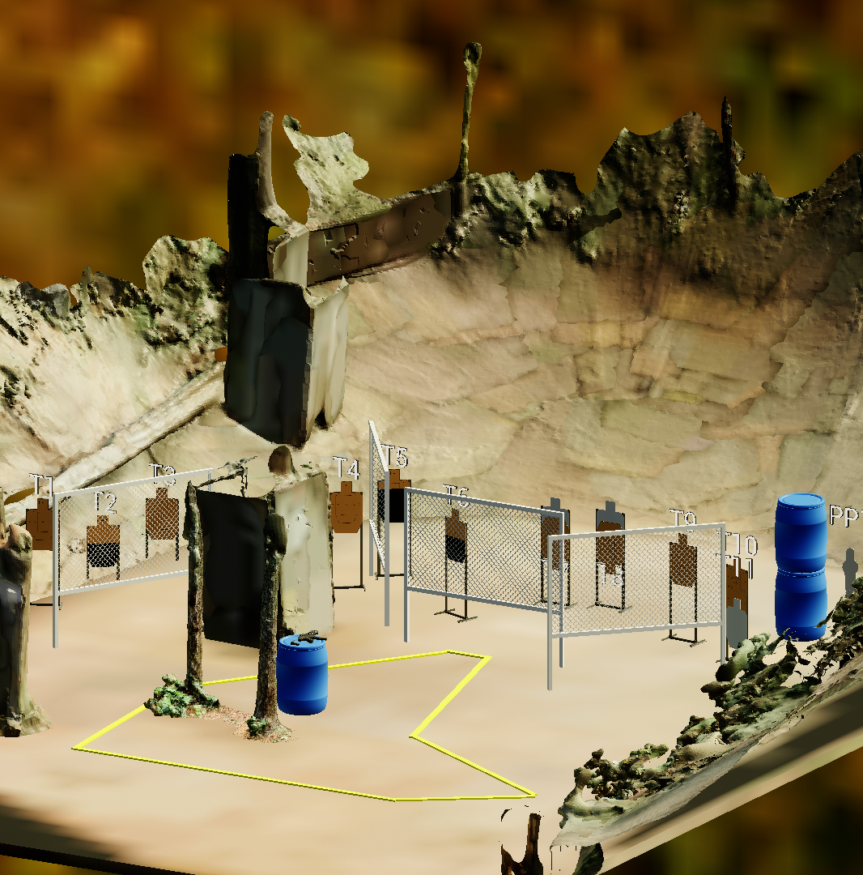
 | Stage 6 Duck Duck Goose Course Designer: Jordan Rogers

Slide 14
Bay 6, Stage 7 RFGC Bowling League Course Designer: Jordan Rogers
RFGC Bowling League is a 20 round, 100 point Comstock medium course. There are 7 USPSA targets and 6 steel targets. The best two hits per target will score. Steel must fall to score. The start signal is audible.
The Handgun start position is anywhere inside either shooting area, handgun UNLOADED and holstered. The PCC start position is anywhere inside either shooting area, PCC UNLOADED, stock on belt, muzzle pointing down range with safety on.
On the audible start signal, engage targets as visible from within the shooting areas. THE LAST 3 TARGETS MUST BE ENGAGED WEAK HAND/SIDE ONLY. All barrels are soft cover.

Slide 15
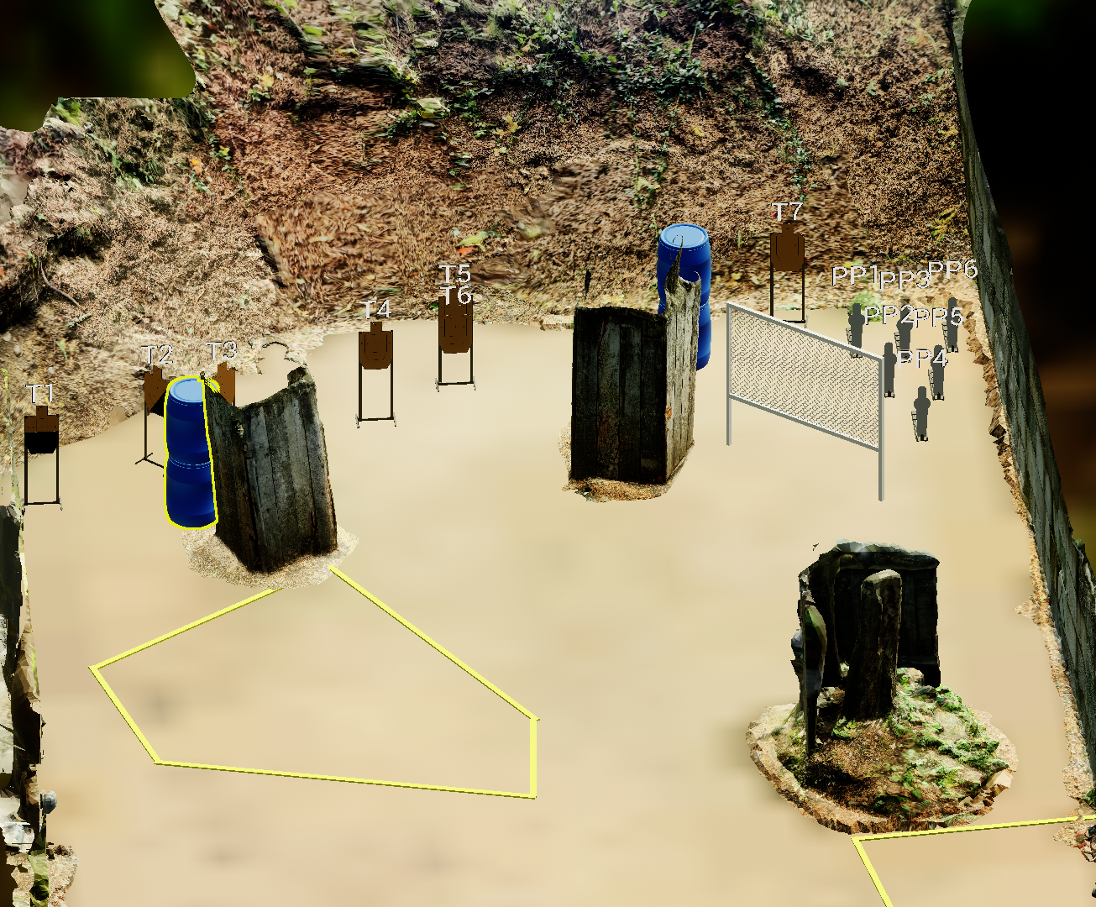
 | Stage 7 RFGC Bowling League Course Designer: Jordan Rogers

Slide 16
Stage 7: Classifier TBD (we’re trying to fit 21-01 in the bay on setup)

